Slide 1



Welcome to PowerPoint
CORONA VIRUS
5 tips for a simpler way to work
ANALYSIS
SQL and Data analysis skills in Real-world context
INTERSHIP PROJECT BY
Mentorness

Slide 2
Welcome to PowerPoint
CONTENTS
Project Overview
Dataset Description
Data Exploration and analysis
5 tips for a simpler way to work

Slide 3
Welcome to PowerPoint
Project Overview
The CORONA VIRUS pandemic has had a significant ipact on public health and has created an urgent need for data-driven insights to understand the spread of the virus.
5 tips for a simpler way to work
As a data analyst, I analysed the CORONA VIRUS dataset to derive meaningful insights and present my findings.

Slide 4
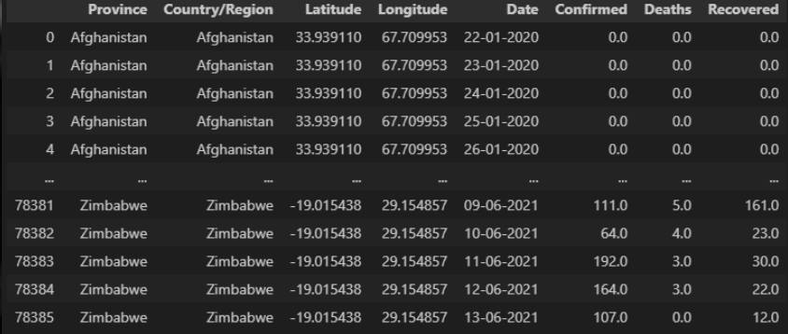
Welcome to PowerPoint
Dataset Description
5 tips for a simpler way to work

Slide 5
Welcome to PowerPoint
Description of each column in the dataset:
Province: Geographic subdivision within a country/region.
Country/Region: Geographic entity where data is recorded.
Latitude: North-south position on Earth's surface.
Longitude: East-west position on Earth's surface.
Date: Recorded date of CORONA VIRUS data.
Confirmed: Number of diagnosed CORONA VIRUS cases.
Deaths: Number of CORONA VIRUS related deaths
Recovered: Number of recovered CORONA VIRUS cases.
5 tips for a simpler way to work

Slide 6
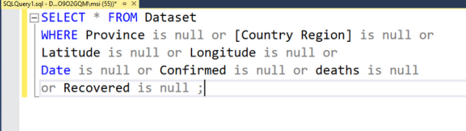
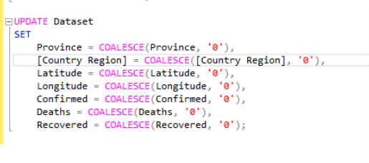
Welcome to PowerPoint
Data Exploration and analysis
DATA CLEANING
Checking for NULL Values
5 tips for a simpler way to work
Updating NULL VALUES

Slide 7
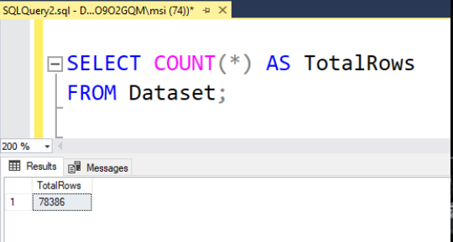
Welcome to PowerPoint
CHECK THE TOTAL NUMBER OF ROWS
5 tips for a simpler way to work

Slide 8
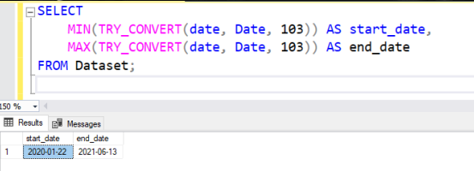
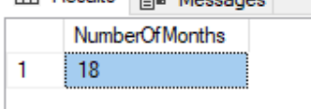
Welcome to PowerPoint
Start_date and End_date
5 tips for a simpler way to work
Number of months present in our dataset

Slide 9
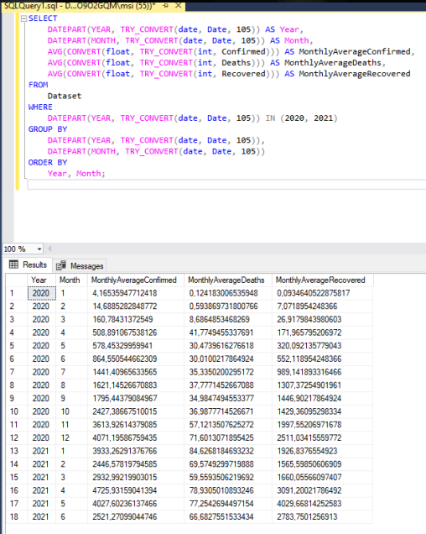
Welcome to PowerPoint
Monthly average for confirmed , deaths, recovered
5 tips for a simpler way to work

Slide 10
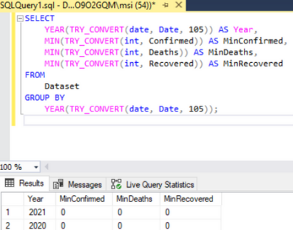
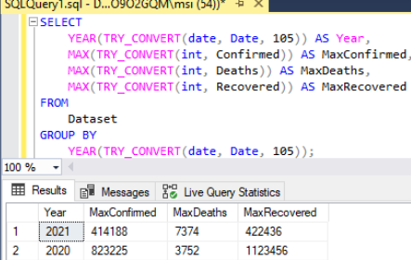
Welcome to PowerPoint
Minimum values for confirmed, deaths, recovered per year
5 tips for a simpler way to work
Maximum values of confirmed, deaths, recovered per year

Slide 11
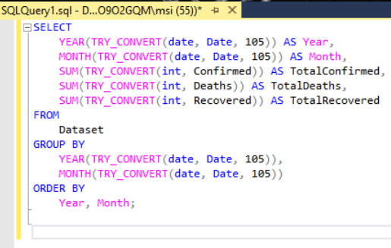
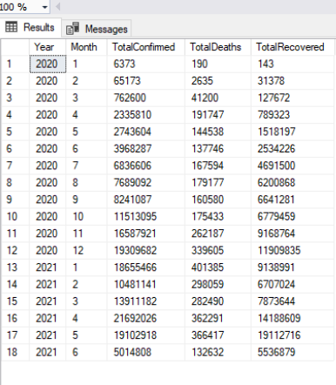
Welcome to PowerPoint
The total number of case of confirmed, deaths, recovered each month
5 tips for a simpler way to work

Slide 12
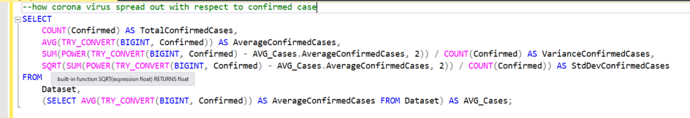
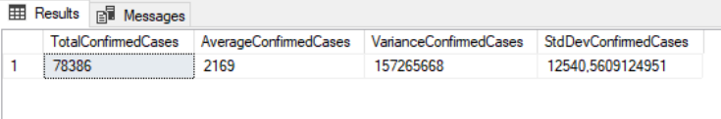
Welcome to PowerPoint
How corona virus spread out with respect to confirmed case
5 tips for a simpler way to work

Slide 13
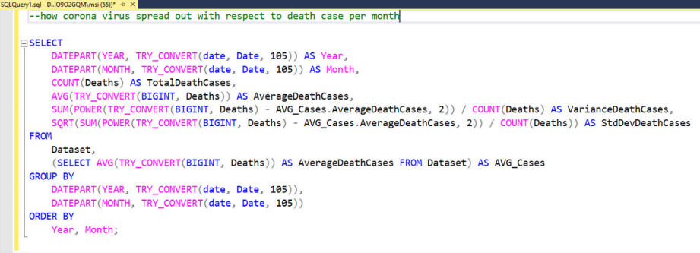
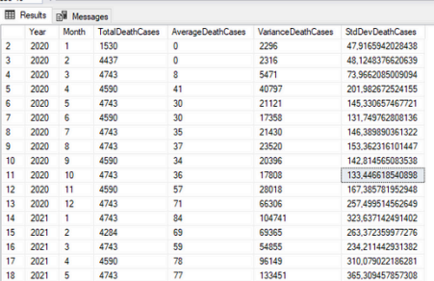
Welcome to PowerPoint
How corona virus spread out with respect to death case per month
5 tips for a simpler way to work

Slide 14
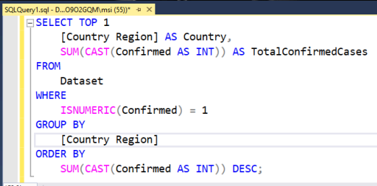
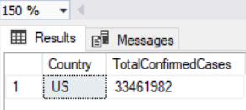
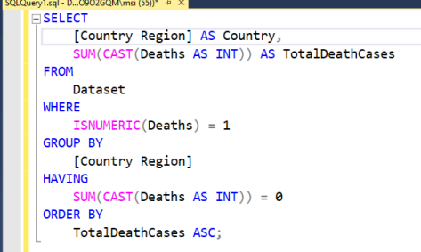
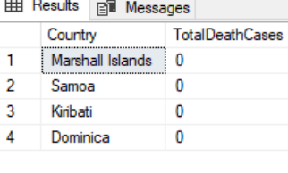
Welcome to PowerPoint
Country having highest number of the Confirmed case
5 tips for a simpler way to work

Slide 15
Welcome to PowerPoint
Countries having lowest number of the death case
5 tips for a simpler way to work

Slide 16
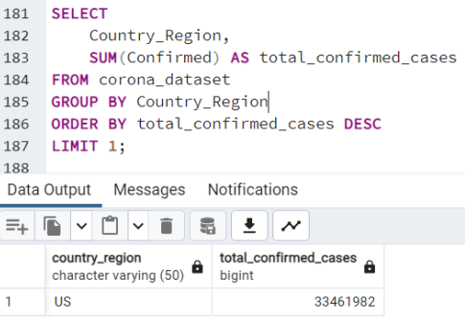
Welcome to PowerPoint
Find the country having the highest number of confirmed cases
5 tips for a simpler way to work

Slide 17
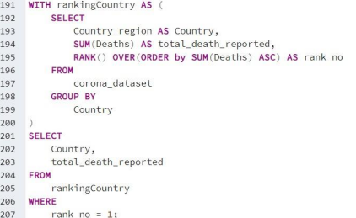
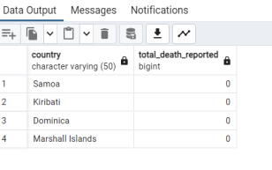
Welcome to PowerPoint
Find the country having the lowest number of death cases
5 tips for a simpler way to work

Slide 18
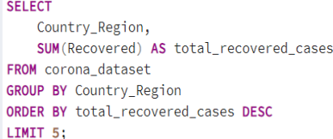
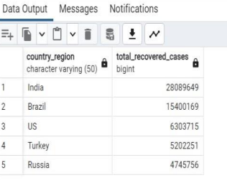
Welcome to PowerPoint
Find top 5 countries having highest recovered cases
5 tips for a simpler way to work

Slide 19
Welcome to PowerPoint
Insights
COVID-19 Pandemic duration: January 22, 2020, to June 13, 2021.
2.India hasthe highest number of recovered cases.
3.Samoa, Kiribati, Dominica, and the Marshall Islands have the lowest death counts.
4.The US leadsin confirmed COVID-19 cases.
5.Peak confirmed cases occurred in April 2021.
6.Peak death rate in January 2021
5 tips for a simpler way to work

Slide 20
Welcome to PowerPoint
Thank you!
5 tips for a simpler way to work

